Slide 1

Workshop : 2
Data Science & AI BOOTCAMP Workshop
“Our Limit is the Space”

Slide 2
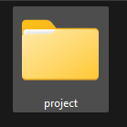
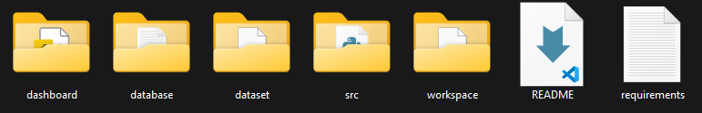
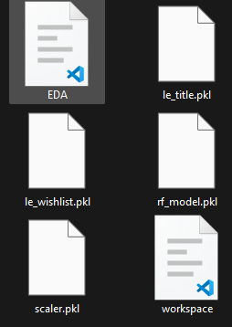
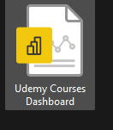
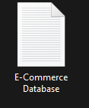
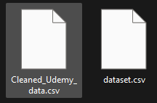
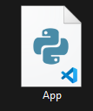
Project Structure
Today we will work with
Today we will work with

Slide 3
1. Exploratory Data Analysis (EDA):

Slide 4
Step 1
Import our Libraries
import pandas as pd
import numpy as np
import matplotlib.pyplot as plt
import seaborn as sns
from sklearn.preprocessing import StandardScaler
from sklearn.model_selection import train_test_split
from sklearn.linear_model import LogisticRegression
from sklearn.metrics import confusion_matrix, classification_report
Step 2
Drop Null Values
df.dropna(inplace=True)
Step 3
Just a check
info()

Slide 5
Step 4
Make ‘title’ column in lower case and remove special charcters
df['title'] = df['title'].apply(lambda x: x.lower())
df['title'] = df['title'].str.replace('[^a-z0-9\s]', '')
Step 5
Drop Unneeded columns
columns_to_drop = [
'id', 'avg_rating', 'url', 'created', 'num_published_lectures',
'discount_price__currency', 'discount_price__amount', 'published_time’,'is_paid', 'discount_price__price_string','price_detail__currency','price_detail__price_string' , 'avg_rating_recent'
]
df.drop(columns=columns_to_drop, axis=1, inplace=True)
Step 6
Make ‘rating’ column last column
rating = df['rating']
df.drop(columns=['rating'], axis=1, inplace=True)
df['rating'] = rating

Slide 6
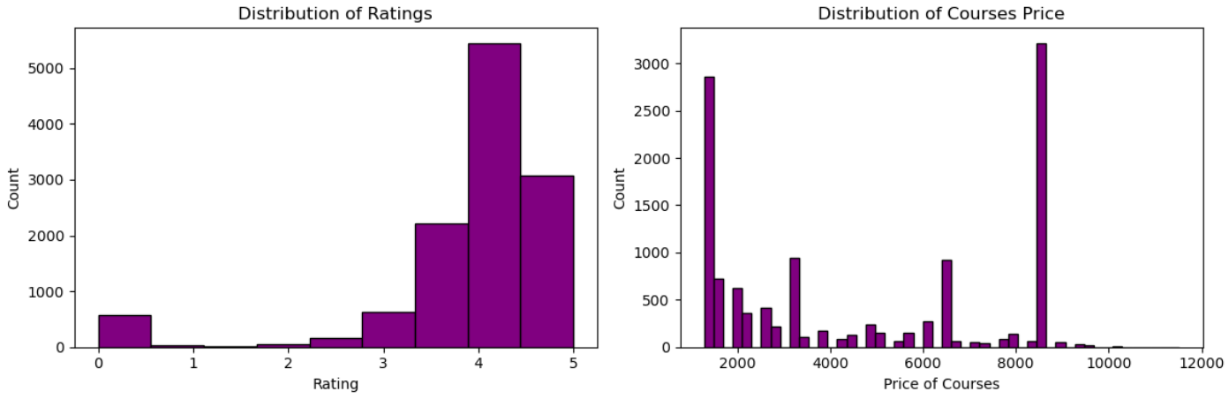
Step 7:
Let’s show our analysis view:
fig, axes = plt.subplots(1, 2, figsize=(12, 4))
# histogram for ratings
axes[0].hist(df['rating'], bins=9, edgecolor='black', color='purple')
axes[0].set_title('Distribution of Ratings')
axes[0].set_xlabel('Rating')
axes[0].set_ylabel('Count')
# histogram for course prices
axes[1].hist(df['price_detail__amount'], bins=50, edgecolor='black', color='purple')
axes[1].set_title('Distribution of Courses Price')
axes[1].set_xlabel('Price of Courses')
axes[1].set_ylabel('Count')
plt.tight_layout()
plt.show()

Slide 7
2. Feature Engineering:

Slide 8
Step 1
Encoding
from sklearn.preprocessing import LabelEncoder
le_title = LabelEncoder()
le_wishlist = LabelEncoder()
df['title'] = le_title.fit_transform(df['title']) df['is_wishlisted'] = le_wishlist.fit_transform(df['is_wishlisted'])
Step 2
Outlier Detection using IQ Method:
def outliers(df, column):
Q1 = df[column].quantile(0.25)
Q3 = df[column].quantile(0.75)
IQR = Q3 - Q1
outlier_indices = df[(df[column] < (Q1 - 1.5 * IQR)) | (df[column] > (Q3 + 1.5 * IQR))].index
return outlier_indices
outlier_indices = outliers(df, 'num_subscribers')
# conveert to dataframe
outlier_indices = pd.DataFrame(outlier_indices)
outlier_indices

Slide 9
Step 3
Scaling the data:
scaler = StandardScaler() X = df.drop('rating', axis=1) # [1:100] --> [-1:1]
y = df['rating']
numerical_cols = ['num_subscribers', 'num_reviews', 'price_detail__amount']
X[numerical_cols] = scaler.fit_transform(X[numerical_cols])

Slide 10
3. ML Model Fitting:

Slide 11
Step 3
Fit our RandomForest regressor model:
from sklearn.ensemble import RandomForestRegressor
from sklearn.model_selection import train_test_split
X_train, X_test, y_train, y_test = train_test_split(X, y, test_size=0.2, random_state=42)
rf = RandomForestRegressor()
rf.fit(X_train, y_train)
Step 2
Evaluate the regression using MSE for training and testing data:
train_pred = rf.predict(X_train)
test_pred = rf.predict(X_test)
from sklearn.metrics import mean_squared_error
print('MSE for training data:', mean_squared_error(y_train, train_pred))
print('MSE for testing data:', mean_squared_error(y_test, test_pred))

Slide 12
Step 3
Evaluate MSE, <AE and R2 score for our test and predict data:
from sklearn.metrics import mean_squared_error, mean_absolute_error, r2_score
y_pred = rf.predict(X_test)
# Evaluate regression metrics
mse = mean_squared_error(y_test, y_pred)
mae = mean_absolute_error(y_test, y_pred)
r2 = r2_score(y_test, y_pred)
print(f"Mean Squared Error: {mse}")
print(f"Mean Absolute Error: {mae}")
print(f"R-squared: {r2}")

Slide 13
Saving model, scaler and encoder using joblib
import joblib joblib.dump(le_title, "le_title.pkl") joblib.dump(le_wishlist, "le_wishlist.pkl") joblib.dump(scaler, "scaler.pkl") joblib.dump(rf, "rf_model.pkl")
Step 4

Slide 14
. Model Deployment:

Slide 15
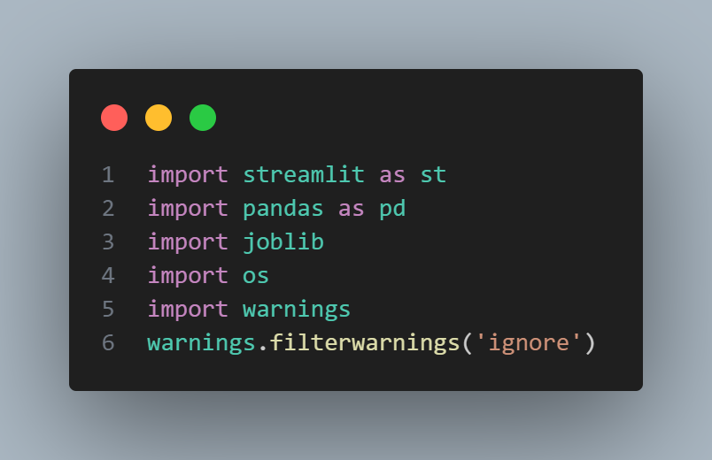
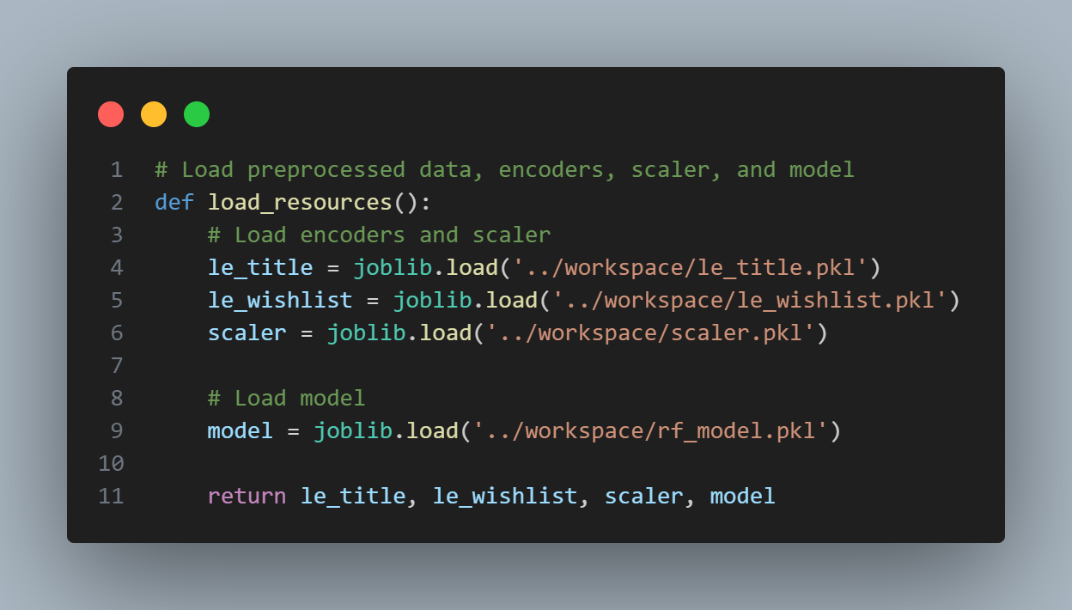
Step 1: Import Our Libraries
Step 2: Load our model, Scaler and Encoderr

Slide 16
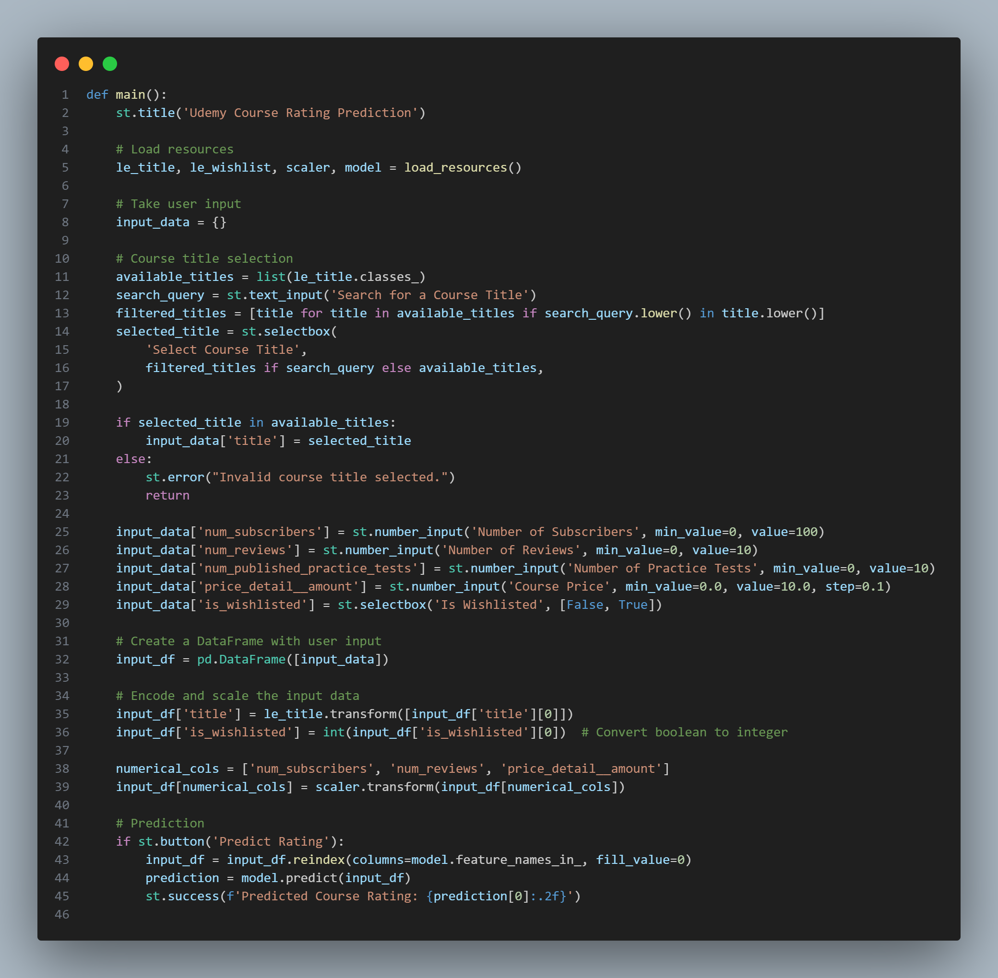
Step 2: Import Our Libraries
Make a title for our web page
Load our Model, Scaler and Encoder
Create a Search Query to filter the courses by a specific text
Take all user inputs
Encode and scale the input data using the loaded scaler and encoderr
Predict the course rating

Slide 17
Don’t forget the Feedbacks

Slide 18
Thanks a lot ☺

